Slide 1

Whack a mole
Press ‘c’ to start
brought to you by the BDM lab

Slide 2
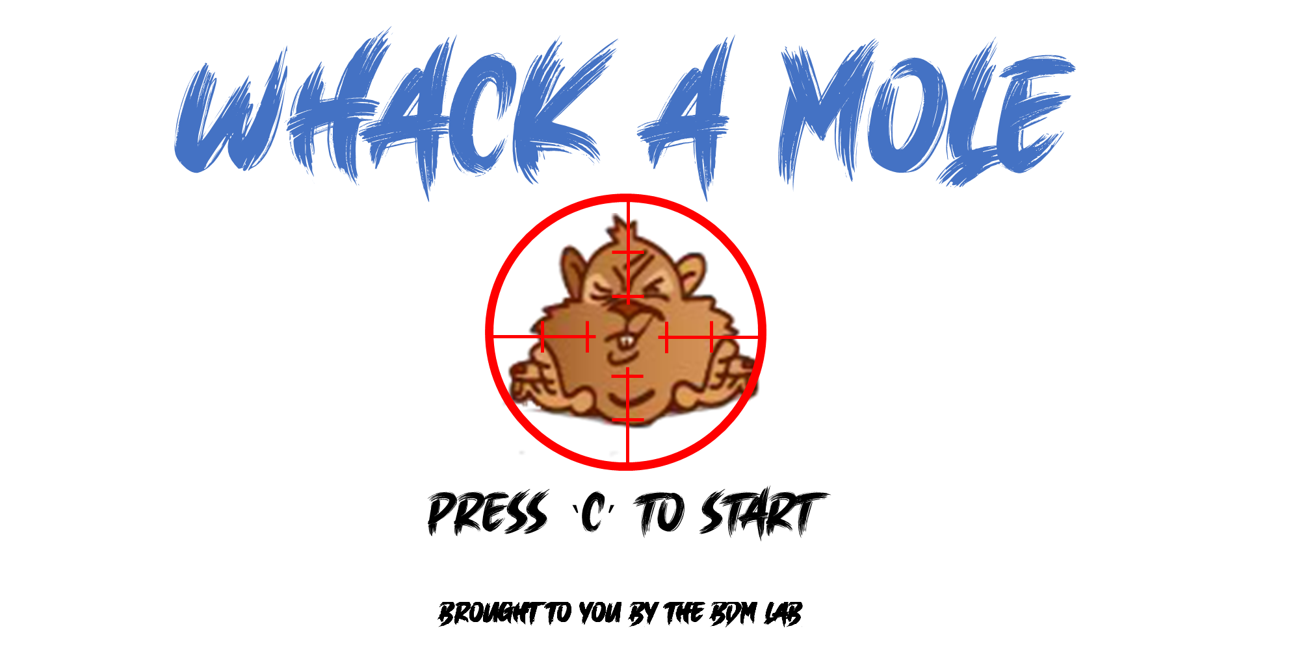

Notes:
8 by 2 the correct size

Slide 3
Whack a mole
Thanks for playinG
You can close the game using the top right x button
brought to you by the BDM lab

Slide 4
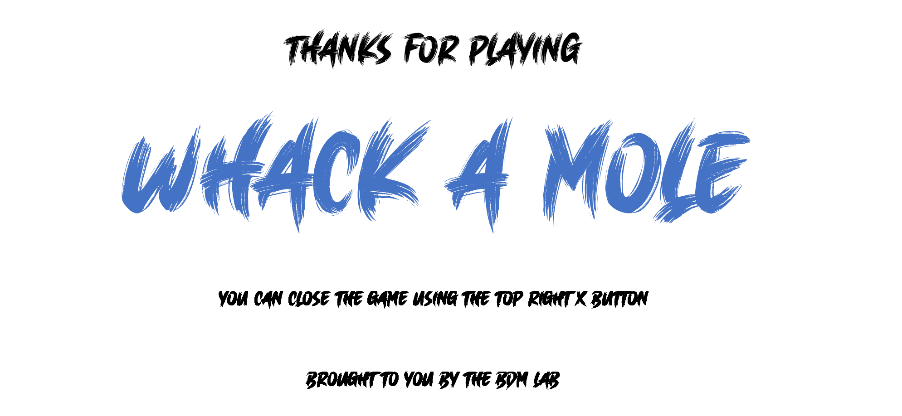
Notes:
8 by 2 the correct size

Slide 5
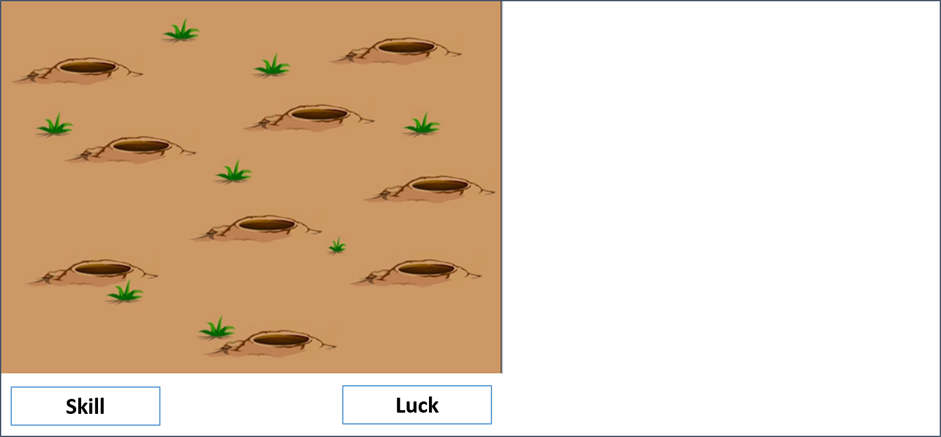
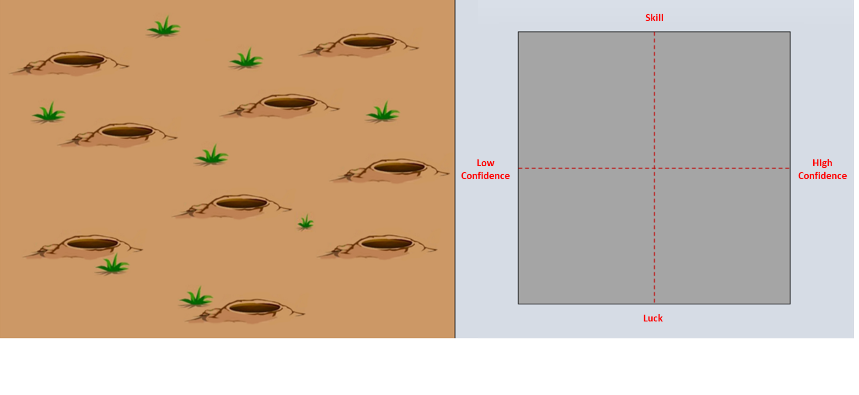
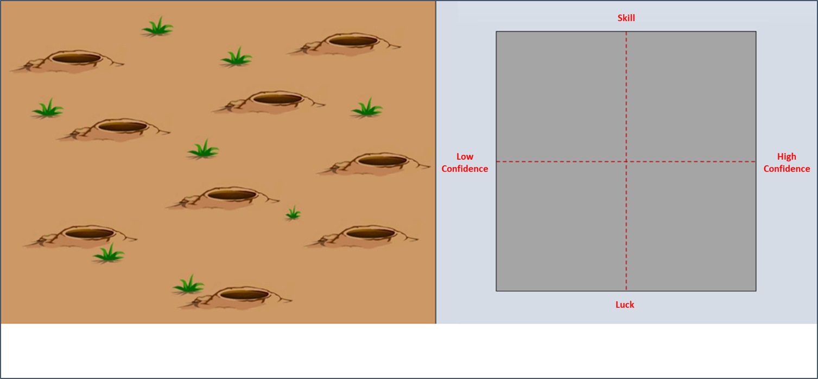
Skill
Luck

Slide 6
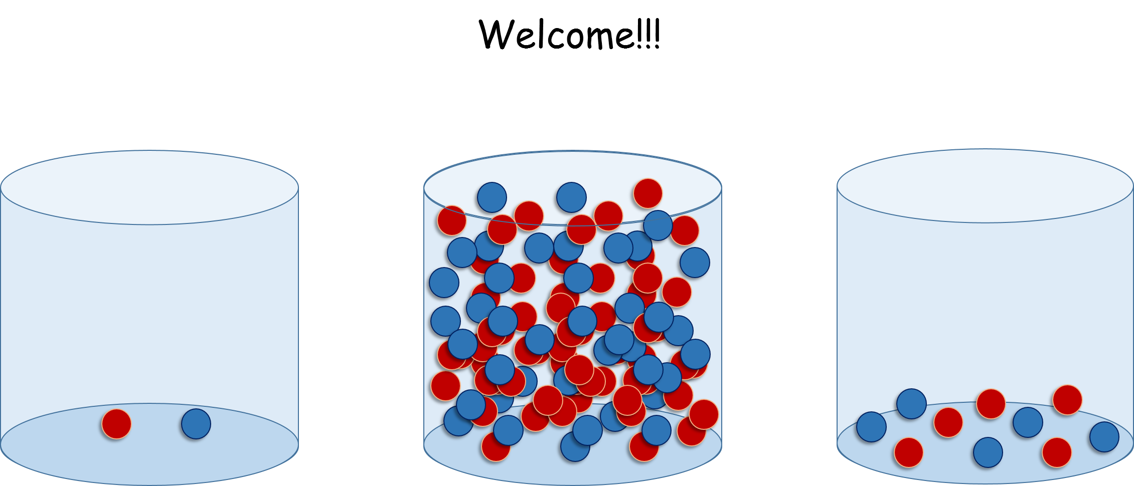

Whack a mole
brought to you by the BDM lab

Slide 7
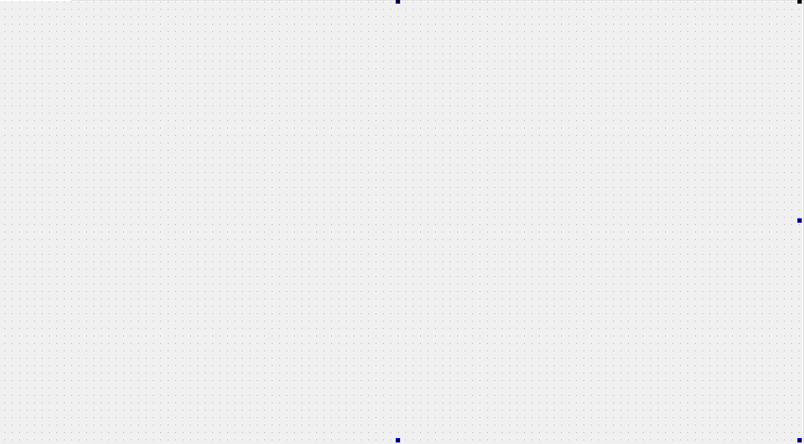
Whack a mole
brought to you by the BDM lab

Slide 8
10
9
8
1
7
6
5
0
4
3
2

